Slide 2
Objective
Overview Window Form
Form class
Types of Control
Basic Controls
Grouping an Graphic Controls
Notes:
Overview: a short description of something that provides general information about it, but no details

Slide 3
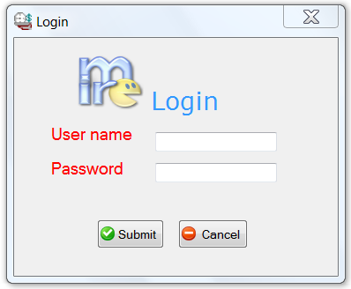
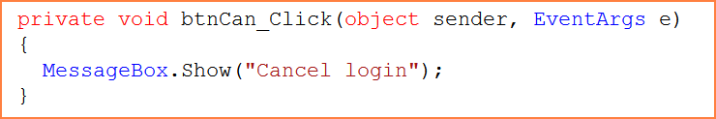
Application
Application
User Interface
Easy to learn
Easy to use
Attractive
Program

Slide 4
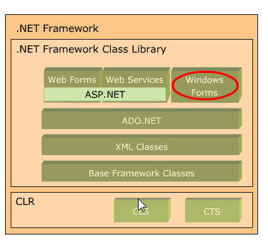
WinForms and .NET Framework
Windows Forms :
are a part of the .NET Framework that is used to build, deploy and run applications.
Provide with a standard programing model in order to create application with least bugs.
Are executed in the .NET CLR runtime.
Notes:
Deploy : to use something or someone, especially in an effective way

Slide 5
Features
Create App with least operation
Click one deployment
Application setting
New Windows Forms controls
New Data Binding model
Rich graphics
Store global data to reuse anywhere
ToolStrip, MenuStrip ….
Powerfull way to link control with data source ( BindingSource component )
GDI+ : drawing and painting image on forms

Slide 6
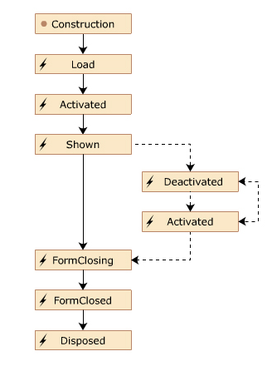
Form
Is the basic unit of an application
Presents information to the user
Receives information from the user.
Is represented as a class in the System.Windows.Forms namespace.
Properties | Text, BackColor, ForeColor, Font, WindowState, AcceptButton, Location, Modal, Name
Methods | Activate, Close, Focus, Hide, Show, Enabled
Events | Load, Activated,Shown,Deactivate, FormClosing, FormClosed, Resize, Click, GotFocus

Slide 7
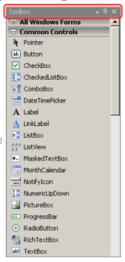
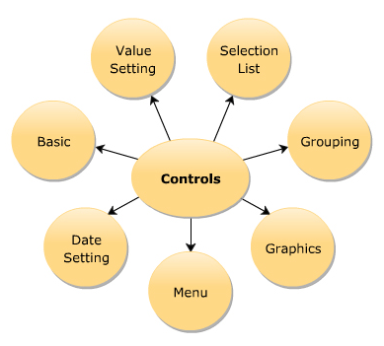
Use of Controls
Control class
Base class of all controls available in WinForms

Slide 8
Control Class
Properties
Method
Event
CanFocus
Controls
Enable
Name
Parent
TabIndex
Visible
Focus
GetNextControl
Hide
IsMNemonic
Select
Show
Click
ControlAdd
DoubleClick
Validating
Validated
KeyPress
Leave
LostFocus
MouseClick
Move
Example
this.[controlname].[propertyname]

Slide 9
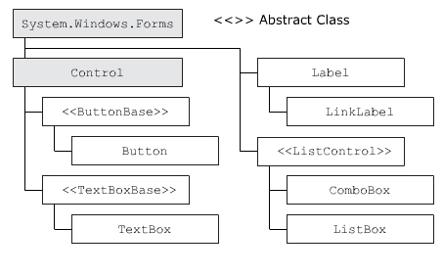
Common Controls
Label
Textbox
Button
ListBox
ComboBox
LinkLabel

Slide 10
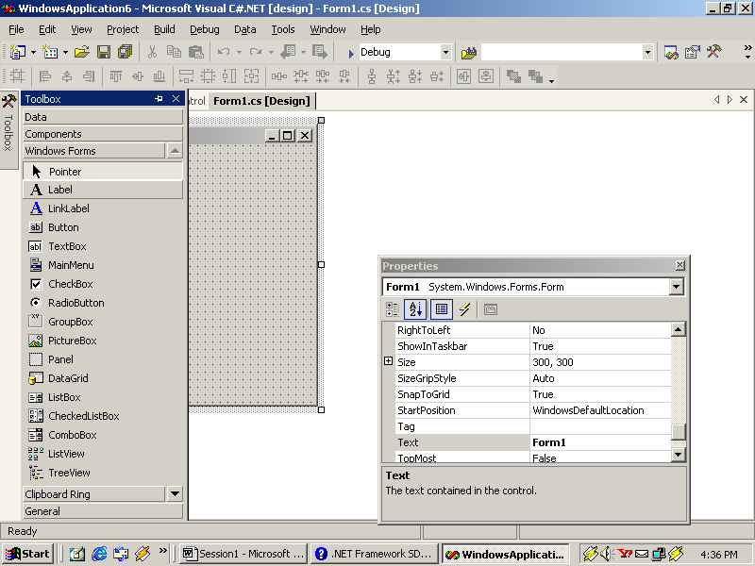
Label
Label
Properties
Method
Event
Name
Text
TextAlign
UseMnemonic
Contains
Hide
Show
Click
Label fName = new Label();
fname.Text = “&First Name : “;
fName.UseMnemonic = true ;

Slide 11
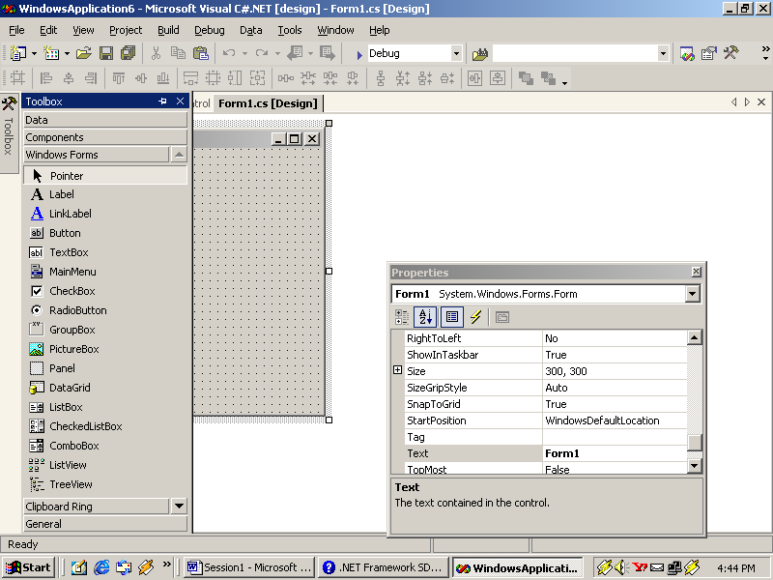
TextBox
Properties
Method
Event
CharacterCasing
MaxLength
MultiLine
Name
PasswordChar
ReadOnly
Text
AppendText
Clear
Focus
Copy
Paste
KeyPress
Leave
TextChanged
TextBox

Slide 12
MaskedTextBox
Properties
Method
Event
Mask
MaskFull
MaskCompleted
Name
PromptChar
Text
GetPositionFromCharIndex
SelectAll
MaskChanged
MaskedInputRejected
MaskedTextBox mks = new MaskedTextBox();
mks.Mask = “00000-9999”;
mks.Text = “095204-7763”;
if(!mks.MaskFull)
{
MessageBox.Show(“Enter proper code …”);
}

Slide 13
Mask
Mask | Description
0 | Digit, required. [0-9]
9 | Digit or space, optional.
# | Digit or space, optional. If this position is blank in the mask, it will rendered as a space in the Text property. Plus (+) and minus (-) are allbe owed.
L | Letter, required [a-zA-Z].
? | Letter, optional. [a-zA-Z].
& | Character, required. If the AsciiOnly property = true, behaves like the "L" .
C | Character, optional. Any non-control character. If the AsciiOnly property =true, this element behaves like the "?" element.
A | Alphanumeric, optional. If the AsciiOnly property =true, the only characters it will accept are the ASCII letters a-z and A-Z.
a | Alphanumeric, optional. If the AsciiOnly property is set to true, the only characters it will accept are the ASCII letters a-z and A-Z.

Slide 14
Button
Properties
Method
Event
DialogResult
Enabled
FlatStyle
Image
Name
Text
Focus
PerformClick
Click
DoubleClick
MouseDoubleClick
Button
Button cmdOK = new Button();
cmdOK .Text = “OK” ;
cmdOK.FlatStyle = System.Windows.Forms.FlatStyle.Flat;

Slide 15
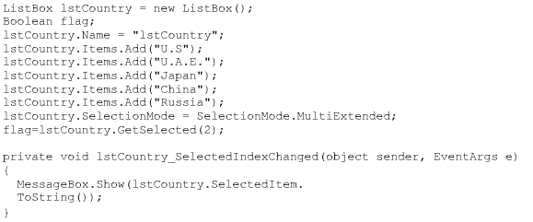
ListBox
Can select multivalues
Properties
Method
Event
DisplayMember
Items
SelectionMode
SelectedIndex
ClearSelected
GetItemText
GetSelected
SetSelected
SelectedIndexChanged
SelectedValueChanged
ValueMemberChanged

Slide 16
ComboBox
Properties
Method
Event
DropDownStyle
Items
MaxDropDownItem
SelectedItem
SelectedIndex
Text
ValueMember
GetItemText
SelectAll
Select (int start, int len)
DropDown
SelectedIndexChanged
SelectedValueChanged
ValueMemberChanged

Slide 17
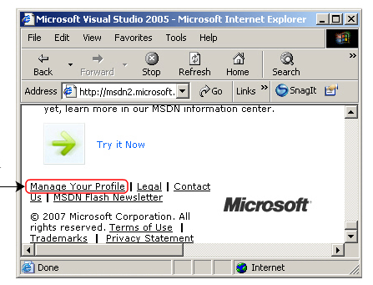
LinkLabel
Display a Hyperlink that link to a Web Page or another Window Form
Properties:
ActiveLinkColor , Links , LinkColor , LinkVisited, Text, VisitedLinkColor
Method : Select
Event : LinkClicked
Notes:
System.Diagnostics.Process.Start("http://www.google.com");

Slide 18
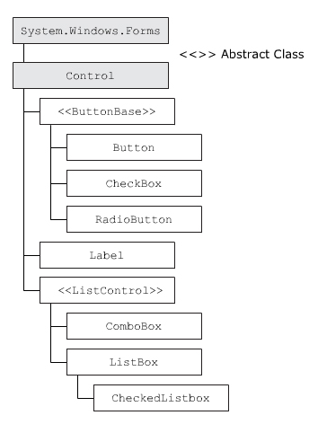
Grouping Controls
Value Setting ControlForm class
RadioButton
CheckBox
CheckListBox
Grouping Controls
GroupBox
Panel
Images Control
PictureBox
ImageList

Slide 19
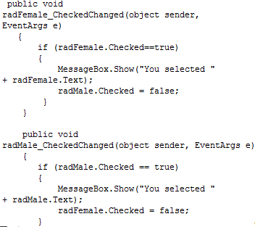
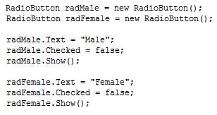
RadioButton
Properties
Method
Event
Appearance
AutoCheck
Checked
Image
PerformClick
Select
Show
CheckedChanged
Click
Notes:
Appearance: normal/button

Slide 20
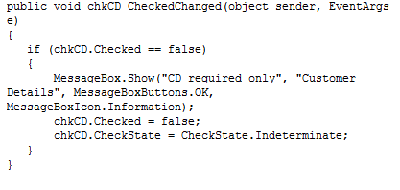
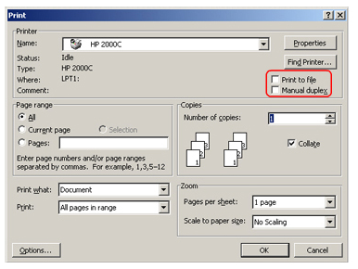
CheckBox
Properties
Method
Event
Checked
CheckState
ThreeState
Select
Show
CheckedChanged
CheckStateChange
Click

Slide 21
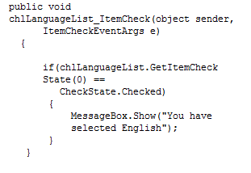
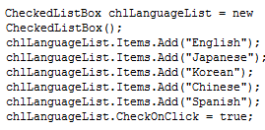
CheckedListBox
Properties
Method
Event
CheckedIndices
CheckedItems
CheckOnClick
Items
SelectedValue
SelectedItems
SelectedItem
ClearSelected
GetItemChecked
GetItemCheckState
GetItemText
SetItemChecked
SetItemCheckState
ItemCheck
MouseClick
SelectedIndexChanged
SelectedValueChanged

Slide 22
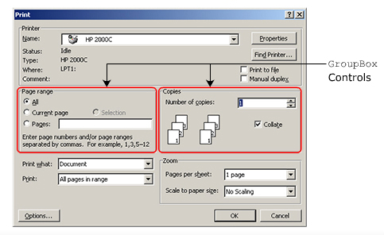
Grouping Control
Panel
Contains other Control
GroupBox
As Panel but appear as Frame around Control

Slide 23
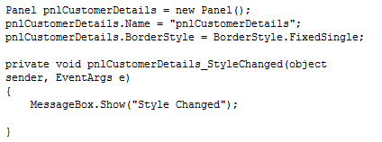
Panel
Properties
Method
Event
AutoSize
AutoSizeMode
BorderStyle
Select
Show
StyleChanged
VisibleChanged

Slide 24
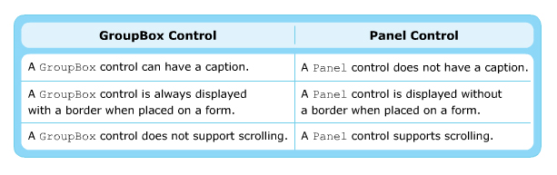
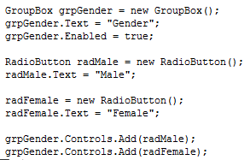
GroupBox
Properties
AutoSize, Anchor,
FlatStyle
Method
Hide, Show
Event
StyleChanged,
Resize

Slide 25
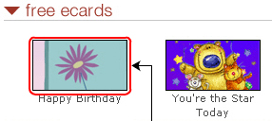
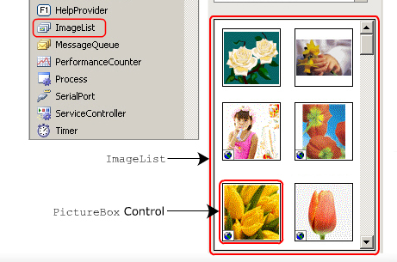
Graphic Controls
PictureBox
Display image on the Form ( .bmp ,.jpg ..)
Can hold sigle image at a time
ImageList
Store collection of images

Slide 26
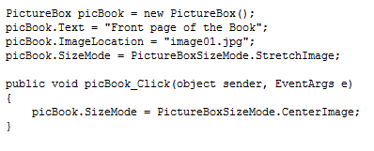
PictureBox
Properties
Method
Event
Image
ErrorImage
InitialImage
SizeMode
Load
LoadAsync
Click
Leave
LoadCompleted

Slide 27
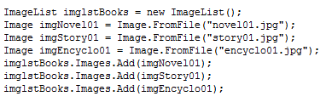
ImageList
Properties
Method
Event
Images
ColorDepth
ImageSize
Name
Draw
RecreateHandle

Slide 28
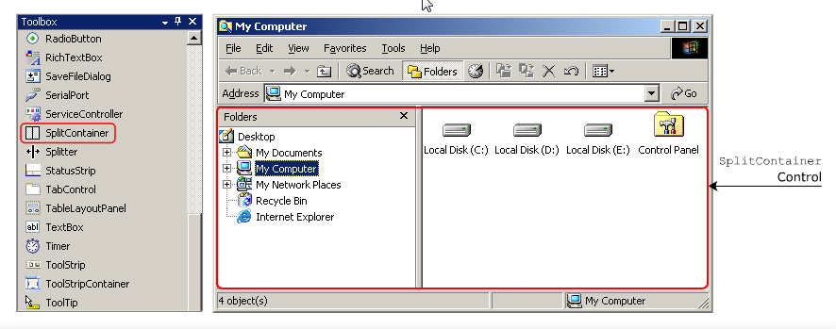
SplitContainer
Divide the form into two resizable panels
As Window Explorer
Properties
BorderStyle
FixedPanel
IsSplitterFixed
Panel1
Panel2
Orientation
Method
OnSplitterMoved
OnSplitterMoving
Event
SplitterMoved
SplitterMoving
Click

